Slide 1
Version 1.7
UCSD CSE 30
Computer Organization and Systems Programming
Class Overview, PA 2 and Introduction to C
Lectures 1- 4 (first part of 4 only)
Keith Muller
DEC PDP 11/45 - 1973

Slide 2
CSE 30 Fall 2022 – Staff Introduction
Instructor: Keith Muller
Office Hours In Person Only: CSE 3109
Tue, Thu: 2:00 PM to 3:00 PM
Additional Office Hours – Zoom Only
Wed: 3:00 PM to 4:30 PM
Zoom: https://ucsd.zoom.us/j/94331007124
Additional Office Hours by Appointment
Email Request to muller@eng.ucsd.edu
Do not use canvas messages to contact me!
Lecture is required!
A lot of material is only available in lecture
If you miss lecture, see the podcasts
TA's
Rasika Bhave
Jinhao Liu
Sananya Majumder
Jerry Yu
Tutors
Nitya Agarwal; Alexander G Arias; James Bao; Shubham Bhargava; Adrian Botvinik; Tianyi Irene Chen; Melina Kapsogeorgou; Thuan Quang Do; Ruilin Hu; William Hu; Jinya Jiang; Mihir Kekkar; Austin Li; Binghong Li; Frank Li; Gerui Li; Meihui Liu; Rana Lulla; Saransh Malik; Hyunseo Park; Annie Phan; Prashanth Rajan; Adrian Rosing; Jordan Ruggles; Andrew Russell; Jose Salazar; Arjun Sampath; Michael Shao; Xiyan Shao; Catherine Shen; Marcelo Shen; Christian Sulaiman; Timothy Wu; Benjamin Xia; Zenas Zhu
x

Slide 3
Quick Overview of Syllabus – See Canvas
PAs
9 assignments – 50 pts each (450 total)
Weekly PA's due Wed night (except Thanksgiving week) starting Sept 28
Late submission up to Saturday night (-5, -10, -15)
8 Slip days for the entire quarter (applied at the end when grades are calculated) to offset Late penalties
No work accepted after late submission date
Special circumstances (e.g., extended absence, contact me right away)
Weekly Canvas Reading quiz
50 pts total
Due Sunday night
Midterm – In Person
150 pts
Oct. 27th evening in-person
Final – In Person
350 pts
Dec. 9th 11:30 AM – 2:29 PM
Textbooks and References – See canvas
All free via library link
x

Slide 4
My View of CSE30….
A little about me…
Started as a (BSEE, MSEE) microelectronics worked at Bell Labs in R&D – got bored
Changed career/retrained in systems programming/architecture
MS, PhD Computer Science UCSD
45 years as a system (OS) software developer and platform architect
At various start ups
Ran a consulting firm – Next, Apple, General Dynamics, Loral Space Systems, Citibank, …
Worked at several large Fortune 500 Tech companies in Product R&D
Specialized in enterprise storage systems
Last 10+ years as a CTO at a Database company – got bored and retired
Adjunct Professor at UCSD
My Goals for the Class
Complete the Academic Requirements for class but with a focus on making the course more relevant to industry
Practice the skills important to a having a successful career
PA's better representative of real problems
Learn and practice creativity by understanding both how and why software/hardware was designed the way it was
x

Slide 5
Survival Tips
Keep up!
CSE30 gets hard real fast! Do not expect you can do an assignment in 1-2 days
Do not be Shy! Learn to ask questions in lecture and discussion sections!
Raise you hand, send a chat message or call out if I do not see you
I love questions! There are no dumb questions.
I will go too fast in class! You must tell me to slow down!!!
Come to office hours: get to know me, give me a chance to help
I will spend as much time as necessary to help you understand the material
Go to Discussion Sessions, do the readings, ask the TA’s and Tutors, post to piazza - DO THIS PROMPTLY, DO NOT WAIT….
I highly encourage feedback: See me for all Complaints, requests, etc.
I will never penalize anyone for speaking up, bring your class issues to me I will fix it
x

Slide 6
Additional Information
Canvas and Piazza are the primary interfaces for this class
All material, quizzes, assignments, etc., can be found on canvas
Piazza for Q/A and announcements
Send me email for personal matters (Illness, family emergencies etc)
Public posts for general general questions on PA's and lectures
Private posts if you are not sure
DO NOT POST YOUR ASSIGNMENTS ON Piazza
Lecture Support Materials
Slides are available in pptx and pdf format on canvas and I am trying github
https://github.com/cse30-fa22/Muller_CSE30_Lecture_Slides.git
Each slide set covers about 1 week (or so) of lectures
Slides are updated constantly to correct errors and to improve content
Version is at the upper left on the title slide
Please check you have the current version the morning before lecture
x

Slide 7

Back in those Early Years…. Physically Wiring your ”Program”
Early Hardware
Used very simple CPU instructions (primitives)
e.g., a single instruction for adding two integers
Software simple
Closely reflected the actual hardware it was running on
Specify each step manually
How to program:
Physical re-wiring was a major part of programming
Jean Jennings (left), Marlyn Wescoff (center), and Ruth Lichterman program ENIAC at the University of Pennsylvania, circa 1946. Photo: Corbis
http://fortune.com/2014/09/18/walter-isaacson-the-women-of-eniac/
x

Slide 8

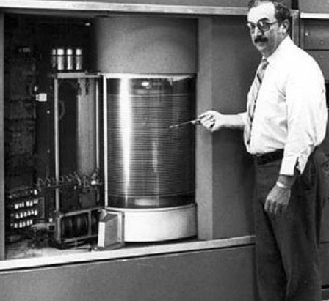
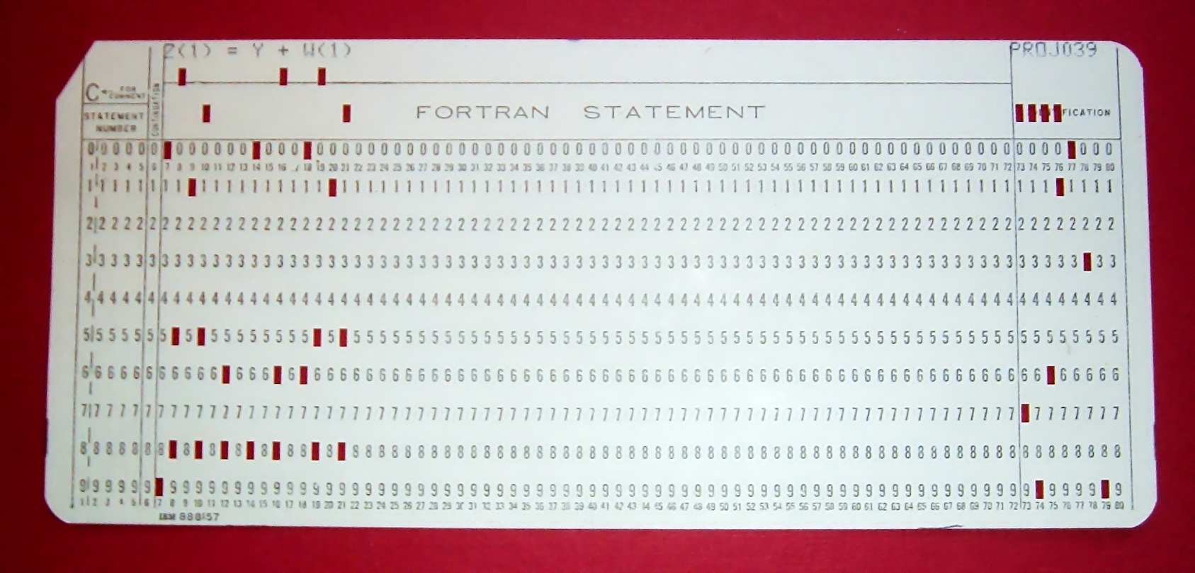
1950-1970 Computers –Abstraction Arrived
Code onto Punched cards, no back spacing to correct typos! I was doomed to fail….
First HDD
“rotating rust”
5 MB
$10,000/MB
Executable file
Binary format
Assembly Language Created
Programming Got Easier with assemblers
1 assembly instruction = 1 machine hardware instruction
More human-readable syntax
add r3,r2,r3
mov r0,3
bx lr
Assembler
01 10 11 00
11 10 11 10
11 00 10 11
assembly
language
source.S
Hardware "executes" machine code
x

Slide 9
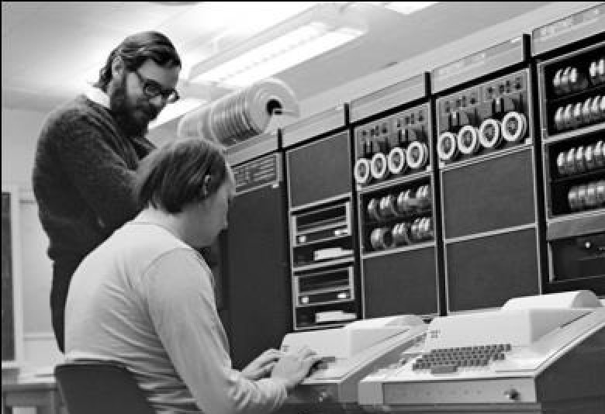
C Programming Language – High Level Language
1975
C was developed by Dennis Ritchie in 1969–73 to make the Unix operating system more portable
Procedural language based on the use of functions()
C was designed to give programmers “low-level” access to memory and be easily translatable into “machine code”
assembly language
source.S
Executable file
binary format
a.out
C language source.c
int
sum_ints(int x,int y) {
return (x + y);
}
Compiler
add r3,r2,r3
mov r0,3
bx lr
Assembler
01 10 11 00
11 10 11 10
11 00 10 11
Hardware "executes" machine code
x

Slide 10
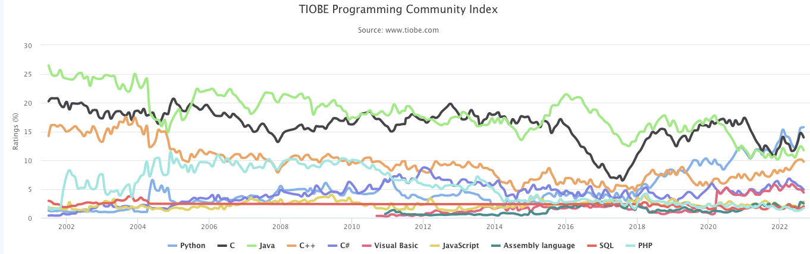
Programming Language Popularity
https://www.tiobe.com/tiobe-index/
x

Slide 11
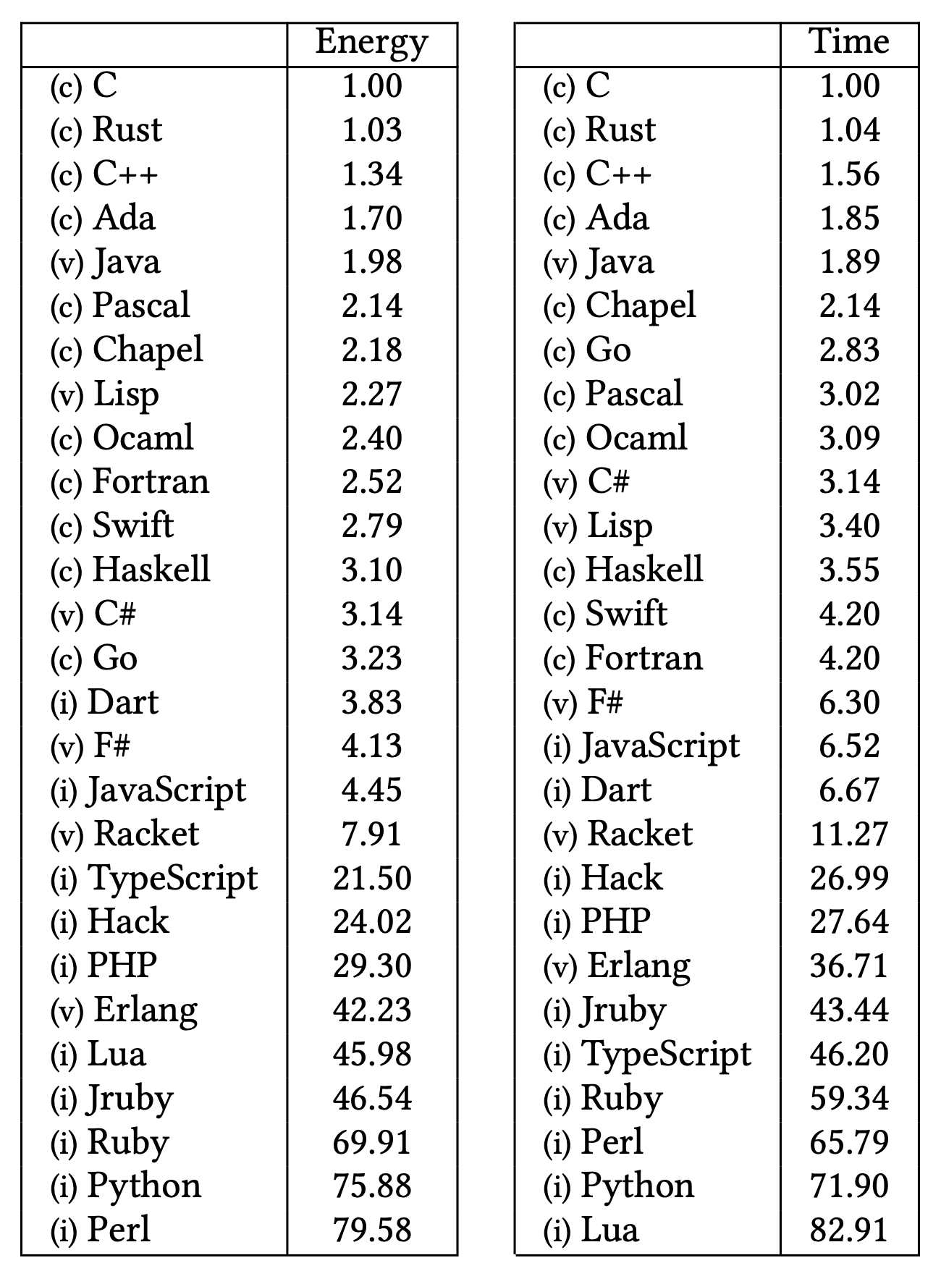
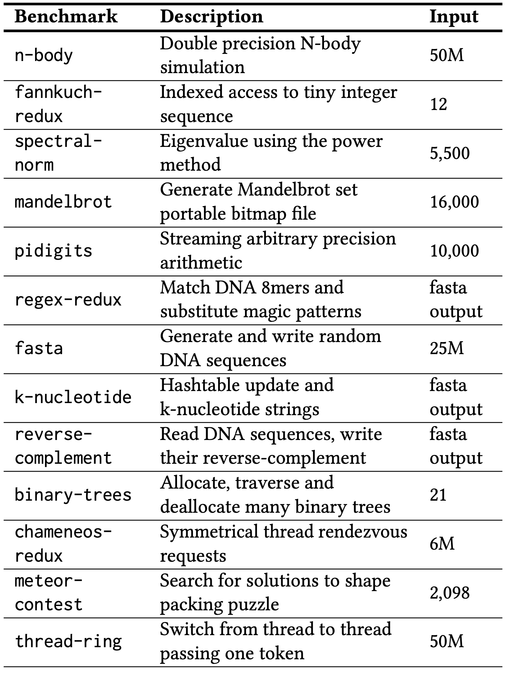
Program Performance by Language
Performance Summary (Ratios Best to Worse)
Energy Efficiency across Programming Languages, How Do Energy, Time, and Memory Relate? , Pereira, Couto, Ribeiro, Rua, Cunha, Fernandes, Saraiva, SLE 2017
https://greenlab.di.uminho.pt/wp-content/uploads/2017/10/sleFinal.pdf

Slide 12


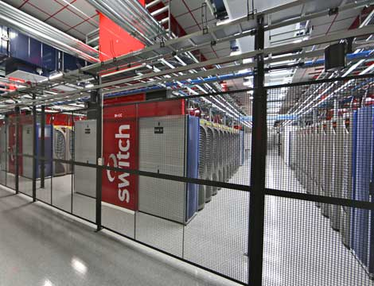
Course Goals - 1
Introduction to System Programming
"Back-end/enterprise" server software
Learn a new programming language:
C is widely used in industry
Basic tools for large software projects
Development: make, gcc, gas
Debugging: gdb, valgrind
Linux application programming
C System libraries
Some Linux Operating system calls
I/O: files, keyboard/screen, basic Inter-process communication
Teradata MPP Database System:
Ebay at Switch Datacenter Las Vegas NV
x

Slide 13
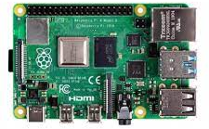
Course Goals – 2
int
sum(int x, int y) {
return(x + y);
}
C language
Text File
Runtime Implementation In Linux
Looking "under the hood"
Design of a Linux executable (process runtime environment)
Instruction Set Architecture: Learn a subset of the ARM 32-bit assembly language
Linux runtime (execution) support: How to implement high-level language semantics (local variables, function calls etc.) in assembly
Compile
sum_ints:
……
add r3, r2, r3
mov r0, r3
bx lr
Assembly language
Human readable version of machine code Text file
Assemble
400575: 81 fe 89 32
81 54 22 af
81 22 10 9A
Machine code
Translation of Assembly object File (.o)
raspberry pi4
Raspberry Pi4B
programs execute under the Linux Operating system on ARM CPU's
x
x

Slide 14
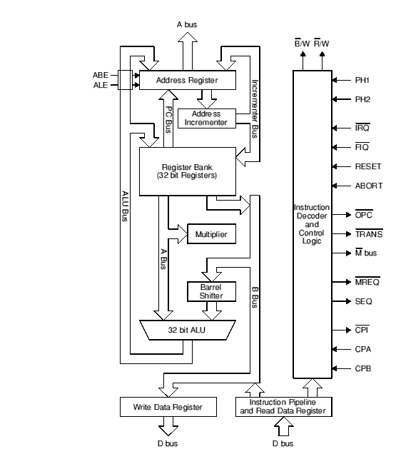
Course Goals – 3 (as time permits)
CPU Datapath
Single ARM Core Floorplan
Brief Introduction to Computer Hardware and Architecture (CPU Datapath)
gates, muxes, ALU, memory, shifters
x

Slide 15
Introduction: C Program Structure (Single file)
#include <sys/system_files.h> // /usr/include/sys/system_files.h
#include <system_files.h> // /usr/include/system_files.h
#include "local_file.h" // local_file.h
/* This is a C style comment */
// this is a C++ style comment
int main(int argc, char *argv[]) // or int main() or int main(void)
{
char x = '\n';
printf("Hello World!%c", x);
printf("Hello\
Tritons\n");
return EXIT_SUCCESS; // for linux scripts; or EXIT_FAILURE
}
/* define other functions */
cpp
directives
first function to run
char literal '\n'
string literal "Hello World!%c"
\ immediately followed by a newline is a line continuation same as "Hello Tritons\n"
x

Slide 16
Five Step Workflow in the Linux Environment, Single Source File
#include <stdio.h>
#include <stdlib.h>
/* A simple C Program */
int
main(void)
{
printf("Hello World\n");
return EXIT_SUCCESS;
}
<stdio.h>
<stdlib.h>
% gcc –Wall –Wextra –Werror prog.c
include files have function prototype and other declaration (later slides)
contents of included .h files are inserted/expanded by cpp (c pre-processor phase of gcc) into files prior to compilation start at their position in the file
cpp
prog.c
gcc compile
Source to Execution
Five Step Process
Compile
Assemble
Link
Load
Execute
prog.s
arm32 Assembly (.s)
gcc (gas) Assembler
Object file (.o)
arm32 machine code
partial missing libraries
prog.o
Create a linux process
Load into memory & Execute a.out
ld Linkage Editor
Linux Loader
a.out
Links in already compiled standard c library
Executable in machine code file
libc
x

Slide 17
C Preprocessor (cpp): #include, #define and more
The C preprocessor (cpp) transforms your source code before the compiler runs
First step in the C compilation process
cpp is automatically invoked by gcc during compilation
Input to cpp is a C file (text) and output from cpp is still a C file (text - temporary)
A preprocessor directive (#directive) temporarily “modifies” a source file just before it is compiled (but it does not save the modifications to the source file)
Preprocessing: source code is expanded and preprocessed for the compiler
Include files are inserted into the source file (#include <stdio.h>)
Macros are expanded (#define MAX 8) – replaces MAX with 8
Comments are removed /* */ , //
Continued lines (line split) are joined \
You are going to design #3 for PA2 and implement in a C program for PA3
x

Slide 18
Compilation Process Actions
#include <stdio.h>
#include <stdlib.h>
/* A simple C Program */
int
main(void)
{
printf("Hello World!\n");
return EXIT_SUCCESS;
}
cpp: inserts and processes the contents of files here (definitions for getchar() and putchar():
/usr/include/stdio.h & /usr/include/stdlib.h
cpp (c pre-processor): removes the Comment
compiler generates assembly code to call the library function printf() and pass the string "Hello World!"
compile: gcc –Wall –Wextra –Werror prog.c -o prog
cpp processes the file
Compiler (gcc) compiles main to assembly
Assembler (gas – called by gcc) translates the assembly to machine code
Linker (ld) merges the machine code for printf() (from a library) with your programs machine code to create the executable file prog (also machine code)
cpp: replaces EXIT_SUCCESS with 0
x

Slide 19
Textbook Over-ride: Linux Return Value Convention - 1
main() is the first function to start to execute and usually the last
Linux uses a convention on signaling errors at process termination to the "shell"
Remember checking return values in CSE15L scripts?
It is the value often associated with the return statement from main()
In this class, always use the Linux standard return codes as defined in <stdlib.h> when returning from main() or exiting your program
EXIT_SUCCESS // program completed ok; usually 0
EXIT_FAILURE // program completed with error; non-zero value
return EXIT_SUCCESS;
To force a clean program termination from any function in your program, you can call exit()
exit(EXIT_FAILURE); // or exit(EXIT_SUCCESS);
x

Slide 20
Main() Return Value Under Linux - 2
void funcB(void)
{
/* lots of code */
…. exit(EXIT_FAILURE);
/* lots of code */
}
int funcA(void)
{
/* lots of code */
funcB();
return z;
}
int main(void) {
/* Your code here */
x = funcA();
/* lots of code */
return EXIT_SUCCESS;
}
#include <stdio.h>
#include <stdlib.h>
int
main(void) {
/* Your code here */
/* code was successful */
return EXIT_SUCCESS;
}
Example 1
Example 3
#include <stdio.h>
#include <stdlib.h>
int
main(void) {
/* Your code here */
/* a failure occurred */
return EXIT_FAILURE;
}
Example 2
x

Slide 21
Data types: C Versus Java
Data Types | Java | C
Character | char // 16-bit unicode | char // 8 bits (signed or unsigned)
integers | byte // 8 bits short // 16 bits int // 32 bits long // 64 bits | (unsigned, signed) char // 8-bits (unsigned, signed) short // unspecified (unsigned, signed) int // unspecified (unsigned, signed) long // unspecified
Floating Point | float // 32 bits double // 64 bits | float // unspecified double // unspecified
Logical type | boolean | #include <stdbool.h> bool conditional tests that evaluate to 0 are false, true for all other values
Constants | final int MAX = 1000; | // two alternatives to do this #define MAX 1000 // C preprocessor const int MAX = 1000;
x

Slide 22
C vs Java: Expression Type Promotions, Demotions, Casts
Java: demotions are not automatic C: demotions are automatic
Cast: a unary operator(variable_type) explicitly converts the type the value of an expression to variable_type
To explicitly get the floating-point equivalent of the integer variable a you would use a cast and write (float)a
int i;
char c;
i = c; /* Implicit promotion */
/* OK in Java and C */
c = i; /* Implicit demotion */
/* Java: Compile time error */
/* C: OK; truncation */
c = (char)i; /* Explicit demotion using a cast */
/* Java: OK; truncation */
/* C: OK; truncation */
x

Slide 23
Java versus C: Mostly Similar Syntax
int x = 42 + (7 * -5); // variables, types
double pi = 3.14159; // C++ style comment
char c = 'Q'; /* C style comment */
for (int i = 0; i < end; i++) { // for loops
if (i % 2 == 0) { // if statements
x += i;
}
}
while (((x > 0) && (c == 'Q')) || (b == 3)) { // while loops, logic
x = x / 2;
if (x == 0) {
return 0;
}
}
x

Slide 24
Conditional Statements (if, while, do...while, for)
C conditional test expressions: 0 (NULL) is FALSE, any non-0 value is TRUE
C comparison operators ( ==, !=, >, etc.) evaluate to either 0 (false) or 1 (true)
Legal in Java and in C:
Illegal in Java, but legal in C (often a typo!):
i = 0; if (i == 5) statement1; else statement2;
Which statement is executed
after the if statement test?
Depends on what value of i,
is i zero or non-zero
Which statement is executed
after the if statement test?
int i;
// other code if (i) statement1; else statement2;
i = 0; if (i = 5) statement1; else statement2;
Assignment operators evaluate to
the value that is assigned, so….
Which statement is executed
after the if statement test?
x

Slide 25
Logical Data Shortcuts
... int i; ... if (i) /* is the same as (i != 0) */
statement1;
else
statement2;
...
Assignment inside conditional test – often includes a function call (this is very common!)
if ((i = SomeFunction()) != 0) statement1; else statement2;
assignment returns the value that is placed into the variable to the left of the = sign, then the test is made
x

Slide 26
Be Careful with the comma , sequence operator
Sequence Operator ,
expr1,expr2
Evaluates expr1 first and then expr2 evaluates to or returns expr2
Unexpected results with , operator (some compilers will warn)
for (i = 0, j = 0; i < 10; i++, j++)
…
i = 64,323; // i = 64 (assigns first)
i = (64, 323); // i = 323 (value of expression)
x

Slide 27
PA # 2: Designing a Deterministic Finite State Automaton
Deterministic Finite state machine (or a DFA) is a way of representing (or detecting) a language
Example: set of string patterns (e.g., HA) accepted or rejected based on an input sequence
Use Examples
Text Editor: Finding a pattern of text in a file
Hardware: Traffic Light sequencing
Circle (States) and Arc representation
A circle (state) represents memory of what has already been seen before based on the input
An arc represents a transition from one state to the next state for a specified input
The next state can be the same state or a different state
For all possible inputs, there must be just one next state (makes it deterministic)
Also: CSE 105, CSE 140, CSE 131, CSE 123
Arc
Arc
start
1
Arc
2
Arc
3
Arc
end
State
State
State
State
x

Slide 28
States and Transitions
States: Two Special states
start state (initial or first)
end state (we are done or final)
Each arc is labeled with the next input that causes it to be taken
Each arc has a label with the notation (next input / next output):
When an input matches next input that arc is taken
output or action (if any) associated with that input occurs when making that transistion (it is ok to have no output specified)
Detect the string HA
On this input
start
start
end
H/no
H
Output this
A/yes
end
Accepting path only shown
next_input/Associated_output or action
1
2
x

Slide 29
Version 1.7
UCSD CSE 30
Computer Organization and Systems Programming
Class Overview, PA 2 and Introduction to C
Lecture 2 - Sept 27, 2022
Keith Muller
DEC PDP 11/45 - 1973

Slide 30
PA2/PA3: Removing comments from a C program
#include <sys/system_files.h> // /usr/include/sys/system_files.h
#include <system_files.h> // /usr/include/system_files.h
#include "local_file.h" // local_file.h
/* This is a C style comment */
// this is a C++ style comment
int main(int argc, char *argv[]) // or int main() or int main(void)
{
char x = '\n';
printf("Hello World! /* not a comment*/\n");
// C++ comment \
printf("Hello Tritons\n");
return EXIT_SUCCESS; // for linux scripts; or EXIT_FAILURE
}
char literal '\n'
string literal "Hello World! /* not a comment */\n"
\ immediately followed by a newline is a line continuation;
turns the line printf("Hello Tritons\n"); into a comment
x

Slide 31
Designing a Deterministic Finite State Automaton -2
Problem: detect the string HA
Complete the sequence from 3 slides back to make it deterministic
Specify responses on all possible inputs at each state
Make sure every next state transition (arc) is unambiguous (unique – each input selects only one arc)
Recap: Each state represent the memory (history) of inputs in sequence necessary to reach that state
H state: have seen an H
end state: have seen an H immediately followed by an A
start
all other/no
all other/no
H/no
H
H/no
A/yes
end
input / action
x

Slide 32
Designing a Deterministic Finite State Automaton - 3
The state machine on the previous slide would stop after seeing the first HA, and does not take any more input, missing later occurrences of HA in the input
Say you want to process the entire contents of a text file to find all HA's
from the top (top of file)
to the bottom (end of file)
Action: Alter the machine to process input from a text file until the end of the file (EOF) is reached (you process the entire file)
TOF
This is a text file with a lot
of HA in it.
There is a HA here and a HA
there and a HA everywhere.
There is also HA HA HA.
EOF
start
all other/no
all other/no
H/no
H
H/no
A/yes
input / action
end
x

Slide 33
Designing a Deterministic Finite State Automaton - 4
To adjust the DFA to act on continuous input (multiple instances of the pattern), "redirect" the arc(s) that point to the end state to point back at the start state
Delete the existing end state at the bottom (delete shown in the slide build)
Add arcs from each state when EOF on input is detected to a new end state
Remember: Transition (arc) actions (zero or more) associated with a single arc can be anything you need to do
Example: output a string, perform a computation or do noting, etc.
all other/no
start
EOF / -
H/no
end
A/yes
all other/no
H
EOF / -
H/no
A/yes
end
Note we remove this end state in the slide build
x

Slide 34
Merging DFA's: Step one design each sequence
all other/no
all other/no
S/no
S/no
start
S/no
S
O/no
O
L/yes
end
This DFA detects
SOL
all other/no
all other/no
all other/no
S/no
This DFA detects
SA…D
start
S/no
S
A/no
A
D/yes
end
S/no
A/no
S followed by One or more A
ending in D
all other/no
Merge the start states, share initial common sequences (First two states are the same in both)
x

Slide 35
Merging DFA's – 2 (Finished)
This DFA detects both
SOL and
SA…D
all other/no
S followed by One or more A
ending in D
all other/no
O
S/no
O/no
L/yes
S/no
start
S/no
S
end
S/no
all other/no
A/no
D/yes
A
all other/no
A/no
x

Slide 36
Background: What is a Definition in a program language?
Definition: creates an instance of a thing
There must be exactly one definition of each function or variable (no duplicates)
In C you must define a variable or a function before first use in your code
Function definition (compiler actions)
creates code you wrote in the functions body
allocates memory to store the code
binds the function name to the allocated memory
Variable definitions (compiler actions)
allocates memory: generate code to allocate space for local variables
initialize memory: generate code to initialize the memory for local variables
binds (or associates) the variable name to the allocated memory
x

Slide 37
C Function Definitions - 1
returnType fname(type param1, …, type paramN)
{
// statements
return value;
}
C Functions are not methods
no classes, no objects
C function definition
returns a value of returnType
zero or more typed parameters
Every program must have a main() function
main() is the first function in your code to run/execute
main() is not the first code to run in a Linux process, it is called by the C runtime startup code
later in course
function definition
// returns: sum of integers from 1 to max
int
sum(int max) // function definition
{
int i, sum = 0; // variable def
for (i = 1; i <= max; i++) {
sum += i;
}
return sum;
}
x

Slide 38
C Function Definitions - 2
this a C pre-processor (cpp) macro
it is not a variable, it is a "substitution"
// prints sum of integers 1 to MAX
#define MAX 8
int
sum(void) // or sum()
{
int i, total = 0;
for (i = 1; i <= MAX; i++) {
total += i;
}
return total;
}
A function of type void does not return a value
A void parameter or an empty parameter list specifies this is a function with no parameters
A common practice is to use the keyword void to specify an empty or an ignored parameter list
At runtime, function arguments are evaluated, then the resulting value is COPIED to a memory location allocated for the argument (like a local variable)
So, functions are free to change parameter values in their body without side effect to the calling function
C Parameter passing is called: call by value
x

Slide 39
C Function Definitions - 3
In standard C, functions cannot be nested (defined) inside of another function (called local functions)
int outer(int i)
{
int inner(int j) // not in standard c
{
}
}
x

Slide 40
Real C programs are distributed across multiple files
Large programs in one source file can be very difficult to manage
Consider a program with 10 million lines of code
And there are many developers working on it
Approach: C supports programs divided across multiple files (called independent translation units)
While a file is being processed by the compiler, the following is required to generate the assembly:
variables
type, location of variable (adjusted later)
functions
return value type, Location of code (adjusted later)
Number and type of arguments to a function
in this example funcA() must appear before it is used by main() – this is ordering is a pain…
int funcA(int z)
{
int x;
/* lots of code */
return z + x;
}
int main(void) {
int y;
/* lots of code */
x = funcA(y);
/* lots of code */
return EXIT_SUCCESS;
}
x

Slide 41
Background What is a Declaration in programming language?
Declaration: describes a thing – specifies types, does not create an instance
Function prototype describes (more in a few slides …)
The type of the function return value
The types of each of the parameters
Variable declaration describes
The type of a variable that is defined elsewhere
Derived and defined type description
Later slides:(enums, struct, arrays, unions)
In C, you must declare a function or variable before you use it
Use before declaration will implicitly default to int (and a compiler warning/error – not good)
An identifier can be declared multiple times, but only defined once
A definition is also a declaration in C
x

Slide 42
C Translation unit -single source file Range of definition and declaration validity
// sum of integers from 1 to max
#include <stdio.h>
#include <stdlib.h>
#define MAX 8
int sum(int max)
{
int i, sum = 0;
for (i = 1; i <= max; i++) {
sum += i;
}
return sum;
}
int main(void)
{
printf("sum: %d\n", sum(MAX));
return EXIT_SUCCESS;
}
sum() is defined and declared here
Default Definition and declaration validity:
Restricted to the file (called a translation unit) where they are located and
From the point of definition or declaration in that file to the end of that file (translation unit)
sum() is used here
x

Slide 43
Function Prototypes –Definitions and Declaration Sections
returnType fname(type_1, …, type_n);
function prototype
Function prototype (a function declaration)
function header, followed by a semicolon (;) instead of a code block
It specifies the function type (the return type) and parameter types
int sum(int); // function declaration
int sum(int max) // function definition
{
int i, sum = 0;
for (i = 1; i <= max; i++) {
sum += i;
}
return sum;
}
this is the code block
x

Slide 44
Breaking a Program into Multiple files: Declaration (Header) Files and Definition (Source) files
Desired Effect: Say we want to distribute the functions in a program across several source files (translation units), yet allow the functions to call each other
Approach: For each source file, file.c create a header file named file.h
file.h contains just the declarations of the functions (and other things, later…) defined in the source file, file.c that you want visible (exported) for use (called) by functions in other .c files
declarations
function prototypes
A(), B(), C()
function prototypes
D, E
no main.h needed in this example as calling main is likely to create an infinite loop (and not what you wanted)
file1.h
file2.h
#include "file1.h"
#include "file2.h"
function main
#include "file1.h"
function A, B, C
#include "file2.h"
function D, E
definitions
main.c
file1.c
file2.c
Implementation: To call a function defined in another file compiler must know the types and parameter to generate code, so use a #include to import the other source files declaration file
#include the declaration file in your source file at the top of the file; this imports the declaration
x

Slide 45
Header Files (often called .h files) – Where to put declarations
Header file: a file whose only purpose is to be #include’d
Declares interfaces (function prototypes, user defined types, global variable, macros, etc.)
Standard convention (strongly enforced), uses the filename .h extension
There are <system-defined> header files (usually located in /usr/include/…)
#include <stdio.h>
"programmer-defined" header files (usually in a relative Linux path - see –I flag to gcc)
#include "else.h"
Import the interfaces in a C source file by #include-ing it's header (interface) file
What goes where….
.h files only contain declarations, never even think of including a definition statement
Ok in .h files: Function prototypes and global variable declarations (extern int x; - later slides)
.c files never contain prototype declarations for functions that are intended to be exported through the module interface
NEVER EVER #include a .c file
All #includes should go at the top of the file before anything else in the file
x

Slide 46
Placing Declarations and Definitions across Multiple files
// sum of integers from 1 to MAX
#include <stdio.h>
#include <stdlib.h>
#include "sum.h"
#define MAX 8
int main(void)
{
printf("sum(%d): %d\n", MAX, sum(MAX));
return EXIT_SUCCESS;
}
Always #include your own declaration files
compiler will then check that the definition and declarations are consistent
main.c
sum.c
#include "sum.h"
int sum(int max) // function definition
{
int i, sum = 0;
for (i = 1; i <= max; i++) {
sum += i;
}
return sum;
}
inside include files
header (or include) guard
labels are as follows:
filename in all caps
replace the period in the files name with an _
Why needed:
protects the include file from being included multiple times
(we will discuss later….)
#ifndef SUM_H
#define SUM_H
int sum(int); // function declaration!
#endif
header guards
(two lines)
sum.h
header guards
(one line)
x

Slide 47
Breaking a Program into Multiple files: Separate Compilation Support
Desired Effect: When we modify a single file in a multi-source file program, we want to only recompile the file that changed and combine it with an already compiled version of the other files (think of the time to compile a program with 10 million lines of source code)
Approach: Compiler support for independent translation units is called: partial compilation
Compile option to just create a machine code version for each file by itself
file may not be complete (it is missing parts, like the machine code for functions in other files)
Combine the machine code versions together in a separate process (linking) to create an executable machine code file that has machine code for all functions and variable
Exception: code for dynamically linked libraries (you will learn about these in CS120 Operating systems), is linked at run time (when the machine code file is copied into memory and executed)
x

Slide 48
Compiling Multi-File Programs (assembly steps not shown)
"sum.h"
sum.c
sum.o
cpp
gcc –c
cpp
<stdlib.h>
myprog
main.c
main.o
cpp
gcc –c
<stdio.h>
libraries are a
collection of .o files
(e.g. libc)
ld – link editor
(called by gcc)
compile each .c file independently to a .o object file (incomplete machine code)
gcc -Wall –Wextra –Werror –c sum.c # creates sum.o
gcc -Wall –Wextra –Werror –c main.c # creates main.o
link all the .o objects files and library's (aggregation of multiple .o files) to produce an executable file (complete machine code) (gcc calls ld, the linker)
gcc -Wall –Wextra –Werror main.o sum.o –o myprog
x

Slide 49
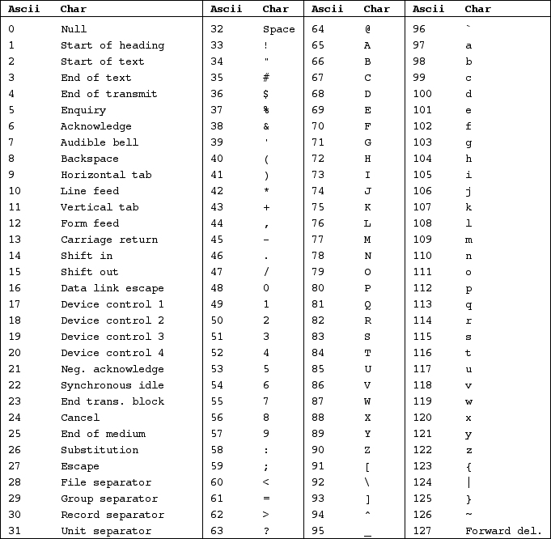
ASCII Use on Linux
\0 in c encodes a null
\b in c encodes a backspace
\t in c encodes a horizontal tab
\n in c encodes a linefeed
ASCII Chars are 0-127 (stored in 8 bits)
x

Slide 50
Version 1.7
UCSD CSE 30
Computer Organization and Systems Programming
Class Overview, PA 2 and Introduction to C
Lecture 3 - Sept 29, 2022
Keith Muller
DEC PDP 11/45 - 1973

Slide 51
char & string literals In C
char sequence | Notes
'a' | letter char
'0' | digit char
'\n' | newline char (encoded)
'\r' | carriage return (encoded)
'\t' | tab char (encoded)
'\b' | back space (encoded)
'\0' | null char (encoded)
'\\' | \ char (escaped)
'\'' | single quote (escaped)
'\"' | double quote (escaped)
Usually used to store characters – thus things like file names
char literals: single quotes 'a'
string literals: Double quotes "string"
Three uses for \ in a C source file
Characters inside literals that the compiler acts on (all forms of white space, a null) are encoded using a two-character sequence starting with a \ to be used within a literal
to escape the special meaning of the next char such as: \' , \", \\ inside literals
Line continuation char \ before a newline at the end of a source line
x

Slide 52
Why literal sequences?
this newline is whitespace in the source code; a single char ASCII linefeed
char x = '
'; // sytax error
char x = '\n';
printf("Hello World!
"); // syntax error
printf("Hello World!\n");
printf("Hello \
world");
printf("the "string""); // syntax error, which is the ending "
printf("the \"string\""); // ok
this is a newline encoded into a char variable initialization
this newline is whitespace in the source code
this is a newline encoded into a literal string (anonymous variable)
this is a line continuation: a \ right before a newline
this " is part of the literal string
x

Slide 53
Recap: Benefit of Separate Declarations and Definitions
subs.h
#ifndef SUBS_H
#define SUBS_H
int funcB(int);
#endif
Using function protypes, putting them into a header file, and including the header file has the following advantages:
Allows any order of function use as the functions are all declared from the point in the file where the #include is located until the end of the file (why we put #include at the top of the file)
Allows the functions to be called from functions defined in a different file
Facilitates separate compilation, as refences to function definitions do not need to be resolved until the object files are recombined by the linker
In the examples to the right
The helper function funcA() in main.c, has a function prototype in main.h, so funcA() does not have to be defined before main() in main.c
The function funcB() which is defined elsewhere, can be used by #including subs.h
main.h
#ifndef MAIN_H
#define MAIN_H
int funcA(int);
#endif
#include "main.h"
#include "sub.h"
int main(void) {
/* lots of code */
x = funcA(y);
return EXIT_SUCCESS;
}
int funcA(int z)
{
return funcB(z);
}
main.c
x

Slide 54
Controlling Linkage Across Files in Multi-File C Programs
Linkage determines whether an object (like a variable or a function) can be referenced outside the file it defined in
External Linkage: function and variables with external linkage can be referenced anywhere in the entire program
Global variables and functions have external linkage by default
Internal Linkage: function and global variables with internal linkage can only be referenced in the same file
Global variables and functions can be changed to internal linkage by using the keyword static
No Linkage: function parameters, variables defined inside a block (including a functions body)
x

Slide 55
Linkage Example - Simplified
#include "foo.h"
int global0 = 1; // external linkage
static int global2; // internal linkage
int funcA(int x) // funcA has external linkage
{
int y; // no linkage
}
static int funcB(void) // internal linkage
{ }
file foo.c
file foo.h
extern int global0;
int funcA(int);
Keyword extern to "extend the visibility", e.g. declare a global variable defined elsewhere
Use of the keyword static in front of a global variable or function definition changes it to internal linkage and effectively makes it private to the file they are defined in
Function definitions in different files (translation units) can re-use the same name if at most one has external linkage (all others must be internal linkage)
extern int x; // declaration
int x = 10; // definition
x

Slide 56
C Storage Durations
C variables have one of the following lifetimes (durations)
Static Storage Lifetime: valid while program is executing
Storage allocated and initialized prior to runtime (implicit default = 0)
Automatic Storage Lifetime: valid while enclosing block is activated
Storage allocated and is not implicitly initialized (value = garbage) by executing code when entering scope
Allocated Storage Lifetime: valid from point of allocation until freed
Storage allocated by call to an allocator function (malloc() etc.) at runtime and is not implicitly initialized (value = garbage) - one allocator does initialize to zero at runtime calloc() – later in course
Thread Storage Lifetime: valid while thread is executing (not CSE 30)
x

Slide 57
Static Storage Duration
#include <stdio.h>
#include <stdlib.h>
int unused; //global static storage duration
int foo(void)
{
static int s=0; //static storage duration
return s += 1;
}
int main(void)
{
for (int i = 0; i < 5; i++)
printf("%d ", foo());
return EXIT_SUCCESS;
}
Sadly, the keyword static has more than one meaning (in addition to controlling linkage) when used with variables
Variables defined with the storage class specifier static always have static storage duration including variables with block scope
Global variables without the storage class specifier static also have static storage duration
All variables with static storage duration are allocated space and initialized before execution starts (default is 0)
% ./a.out
1 2 3 4 5
%
x

Slide 58
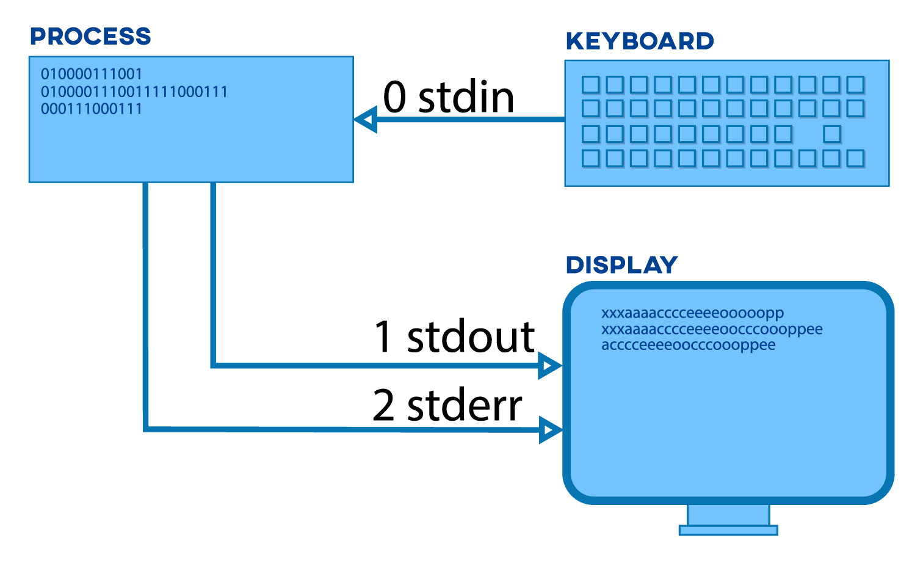
Linux/Unix Process and Standard I/O (CSE 15L) - Defaults
c stdio file handle/pointer (file *)
echo input to output
THIS IS A TEST
Linux OS "file descriptor number"
THIS IS A TEST
THIS IS A TEST
I/O Is not part of C it is supplied in the runtime environment: standard C library
x

Slide 59
Under the Hood: stdio File I/O – File Position Pointer On Files
Read/write functions advance the file position pointer from TOF towards EOF on each I/O
Moves towards EOF by number of bytes read/written
Sequential I/O (sequential read & sequential write)
READ: After the last byte is read in a file, additional reads results in a function return value of EOF
EOF is NOT a character in the file, but a condition on the stream
EOF signals no more data is available to be read
EOF is usually a #define EOF -1 macro located in the file stdio.h
WRITE: specified count of bytes at the file pointer
When file pointer is positioned after the last byte extends the length of the file (increases file length)
TOF
file
Old file position pointer
read N
bytes/chars
New file position pointer
EOF
x

Slide 60
Under the Hood: stdio File I/O – Working with a Keyboard
How do I
signal EOF?
How can you have an EOF with a keyboard?
Streams were designed to work primarily on files
With keyboard devices the semantics of file operations are “simulated”
Example: when a program (or a shell) is reading the keyboard and is blocked waiting for input (it is waiting for you to type a line):
To set an EOF condition from the keyboard, type on an input line all by itself: two key combination (at same time), followed by a return/enter:
cntrl-d (often shown in slides etc. as ^d)
x

Slide 61
C Library Function: Simple Formatted Printing
Task | Example Function Calls
Write formatted data | int status; status = fprintf(stderr, "%d\n", i); status = printf("%d\n", i); /* Writes to stdout */
int fprintf(FILE *file, const char *format, ...);
Write chars to the file identified by file (stdin, stdout, stderr are already open)
Convert values to chars, as directed by format
Return count of chars successfully written
Format is the output specifications enclosed in a "string"
Returns a negative value if an error occurs
int printf(const char *format, ...); // *format - later in course
Equivalent to fprintf(stdout, format, ...);
See man 3 printf for more information on the format
x

Slide 62
Some Formatted Output Conversion Examples
Conversion specifications example
Begin with the % character
Describe a value to be filled in (from a variable or expression argument) during printing
%f conversion specifier for float variables; the default precision is 6
%d conversion specifier for int variables
%c conversion specifier for char variables
many more conversion specifiers (online manual: % man printf and the textbooks)
Output from the printf() would look like
int i = 10; float x = 43.2892;
char z = 'i';
printf("%c = %d, x = %f\n", z, i, x);
i = 10, x = 43.289200
x

Slide 63
C Library Function API : Simple Character I/O – Used in PA3
Operation | Usage Examples
Write a char | int status; int c; status = putchar(c); /* Writes to screen stdout */
Read a char | int c; c = getchar(); /* Reads from keyboard stdin */
#include <stdio.h> // import the API declarations
int putchar(int c);
writes c (demoted to a char) to stdout
returns either: c on success OR EOF (a macro often defined as -1) on failure
see % man 3 putchar
int getchar(void);
returns the next input character (if present) promoted to an int read from stdin
see % man 3 getchar
Make sure you use int variables with putchar() and putchar()
Both functions return an int because they must be able to return both valid chars and indicate the EOF condition (-1) is outside the range of valid characters
Why is character I/O using an int?
Answer: Needs to indicate an EOF (-1) condition that is not a valid char
x

Slide 64
Simple Character I/O – Using STDIO Make sure you use int variables here!
// echo stdin to stdout
#include <stdio.h>
#include <stdlib.h>
int main(void)
{
int c;
while ((c = getchar()) != EOF) {
(void)putchar(c); // ignore return value
}
return EXIT_SUCCESS;
}
% ./a.out
thIS is a TeSt
thIS is a TeSt
^d
%
Always check return code to handle EOF
EOF is a macro integer in stdio.h
Typed on keyboard
Printed by program
Why is c an int?
Returns char in an int or EOF (-1)
Typed on keyboard
Always check return codes unless you do not need it
Sometimes you may see a (void) cast which indicates ignoring the return value is deliberate this is often required by many coding standards
x

Slide 65
C Enumerated Data Type – Use to Specify DFA States
enum tag {enum_0, enum_1, …, enum_n}; // defines just the type
enum tag var; // defines a variable instance
Enumerated type: is a user defined type whose all possible values (typically a small list) are listed by the programmer in the enumeration list
Enumeration tag: identifies the specific enumeration type
The new type is enum tag
Enumeration list: lists one or more enumeration identifier names for each of the possible values
enum suit {CLUBS, DIAMOND, HEARTS, SPADES}; // user defined type
Put this in a .h file
enum suit card = HEARTS; // card defined & initialized to HEARTS
Put this in a .c file
x

Slide 66
C Enumerated Data Type
Enumeration identifiers are really integer constants and can be used as such
Default: compiler assigns a sequential integer value to each name, starting with 0 and incrementing from there. So: 0, 1, 2, 3, …
Over-ride the default value by specifying a unique integer value for each enumeration name
enum compass {NORTH=0, EAST=90, SOUTH=180, WEST=270};
.h file
enum compass direction = WEST; // direction defined & initialized to WEST
.c file
x

Slide 67
Example: Programming a Deterministic Finite Automaton
Rules for this DFA example
Copy input to output while removing everything in "strings" from output
input: ab"foo"cd
output: abcd
Special Case: If Inside a string, a \ is an escape sequence, ignore the next char
Allows you to put an " in a string
input: ab"foo\"bar"cd
output: abcd
end program
Will not need as a state
other / putchar(other)
EOF/No error
EOF/error
EOF/error
start
" / -
quote
\ / -
slash
" / -
all/-
the – means no output
other / -
x

Slide 68
Programming a Deterministic Finite Automaton
end program
Will not need as a state
other / putchar(other)
EOF/No error
EOF/error
EOF/error
start
" / -
quote
\ / -
slash
" / -
all/-
other / -
Use enum to define the states
Declare a set of functions for each state
Each function implements the outbound arcs
returns the next state based on the next input
performs actions associated with arc taken
// process input until EOF in main()
while ((c = getchar()) != EOF) {
// Use a switch statement(state)
// (1) call the current state
// and pass it the input
// (2) it will determine the arc
// (3) it also performs any output
// (4) it returns the next state
}
enum typestate {START, QUOTE, SLASH};
enum typestate startSTATE(int);
enum typestate quoteSTATE(int);
enum typestate slashSTATE(int);
x

Slide 69
Programming a Deterministic Finite Automaton – The Files
Break the program into three files
main.c: is where main loop is, imports the declarations in state.h
states.h: is the interface to the state handlers in states.c
states.c: definition of the state handler functions
states.h
enum user defined type specification
function prototypes
for each state
main.c
#include "states.h"
main() function
states.c
#include "states.h"
function definitions
for each state
x

Slide 70
Version 1.7
UCSD CSE 30
Computer Organization and Systems Programming
Class Overview, PA 2 and Introduction to C
Lecture 4 - Oct 4, 2022
Keith Muller
DEC PDP 11/45 - 1973

Slide 71
Programming a Deterministic Finite Automaton – states{.h,.c}
other / putchar(other)
#include <stdio.h>
#include "states.h"
enum typestate startSTATE(int c)
{
if (c == '\"')
return QUOTE; /* saw a double quote */
putchar(c); /* ok, echo input for everything else */
return START; /* stay in START */
}
enum typestate quoteSTATE(int c)
{
if (c == '\\')
return SLASH; /* saw a backslash ignore next char */
else if (c == '\"')
return START; /* saw the closing " go to START */
else
return QUOTE;
}
enum typestate slashSTATE(int c) /* do we need a function here? */
{
(void) c; /* parameter ignore; a questionable practice! */
return QUOTE;
}
states.c
start
" / -
quote
\ / -
slash
" / -
all/-
other / -
#ifndef STATES_H
#define STATES_H
/*
* type specification for DFA states
*/
enum typestate {START, QUOTE, SLASH};
/*
* function prototypes state handlers
*/
enum typestate startSTATE(int);
enum typestate quoteSTATE(int);
enum typestate slashSTATE(int);
#endif
states.h
x

Slide 72
Programming a Deterministic Finite Automaton – main.c
#include <stdio.h>
#include <stdlib.h>
#include "states.h"
int main(void)
{
int c; /* input char */
int linecnt = 1; /* counts line in input */
int startline = 1; /* starting line number for quote */
enum typestate state = START; /* initial state of DFA */
while ((c = getchar()) != EOF) {
switch (state) {
case START:
state = startSTATE(c);
startline = linecnt;
break;
case QUOTE:
state = quoteSTATE(c);
break;
case SLASH:
state = slashSTATE(c);
break;
default:
fprintf(stderr, "Error: DFA state not handled\n");
return EXIT_FAILURE;
} // end switch
if (c == '\n')
linecnt++; // count the lines
} // end while
/*
* All done. No explicit end state used here.
* We may have had an error condition, what state did we end with?
*/
if (state == START)
return EXIT_SUCCESS;
fprintf(stderr,
"Error: line %d: unterminated quote (\")\n", startline);
return EXIT_FAILURE;;
}
console – I type in blue
% gcc -I. -ggdb -Wall -Wextra -Werror -c main.c
% gcc -I. -ggdb -Wall -Wextra -Werror –c states.c
% gcc -I. -ggdb -Wall -Wextra -Werror main.o states.o
% ./a.out
123"456"789
123789
"123"45"67"
45
"123
456
78"9
9
"
<cntrl-d>
Error: line 6: unterminated quote (")
%
x

Slide 73
Aside: Suppress compiler errors on fall throughs
When writing switch statements in C it is not uncommon to see a case use a fall through to the next case below it
Why do this: First state does extra steps and then the same steps as the "fall through " state
But compilers often (with extra checking flags, using heuristics) will flag this a potential error
Approach: use the comment /* FALL THROUGH */ to fix this (a bit of a "hack" ☺ )
int a = 2;
switch (a) {
case 1:
printf("1\n");
break;
case 2:
printf("2\n");
default:
printf("default\n");
break;
}
% gcc -ggdb -Wall -Wextra -Werror switch.c
switch.c: In function ‘main’:
switch.c:11:9: error: this statement may fall through [-Werror=implicit-fallthrough=]
11 | printf("2\n");
| ^~~~~~~~~~~~~
switch.c:12:5: note: here
12 | default:
| ^~~~~~~
cc1: all warnings being treated as errors
int a = 2;
switch (a) {
case 1:
printf("1\n");
break;
case 2:
printf("2\n");
/* FALL THROUGH */
default:
printf("default\n");
break;
}
% gcc -ggdb -Wall -Wextra -Werror switch.c
% ./a.out
2
default
%
x

Slide 74
Recap: Include files for CSE30
What is ok to place in an a include file
only contain declarations
Function prototypes
int funcA(int);
Global variable declarations
extern int global0;
cpp constants, macros, ifdefs, other #include .h files
#define VALUE 5
#ifdef FOO_h
enum specifications
enum typestate {START, QUOTE, SLASH};
struct specifications (later in course)
struct tagname {
type1 member1;
...
typeN memberN;
};
What is not ok to place in an include file
Anything that allocates memory, such as:
variable definitions
int global0;
constant definitions
const int LENGTH = 5;
function definitions
enum typestate startSTATE(int c)
{
if (c == '\"')
return QUOTE;
putchar(c);
return START;
}
x

Slide 75
Programming Language Concepts: Lifetime
Lifetime (Or Storage Duration)
Duration in terms of program execution is where the contents of a variable is valid to reference in a C statement (by C language specs – not the OS!)
Important: Linux may allow access to a memory location even though the language says you cannot reference the variable (local variables in particular) – later in course when we talk about aliases
This is core concept behind many security exploits
x

Slide 76
Programming Language Concepts: Scope
Scope: Range (or the extent) of instructions over which a name/identifier can be referenced with C instructions
File Scope: Within a single source file (also called a translation unit)
Block Scope: Within an enclosing block (variables only)
Function Scope: goto labels - Not used in CSE30
int global0; /* global variable file scope */
void /* function foo with file scope */
foo(int parm) /* parameter parm block scope begins */
{ // the body (block) of the function begins int i, j = 5; /* variables with block scope */
for (int k = 0; k < 10; i++) { // inner k block scope
// some code
} } // the body of the function ends
x

Slide 77
File Scope Example
The scope of a function or any variable declared outside of any block or parameter list begins at the point of declaration (within the translation unit) and ends at the end of the translation unit (file)
int i; // file scope of i begins
static int g(int a) // file scope of g() begins (note, "a" has block scope)
{
return a;
}
int main(void) // file scope of main() begins
{
int x = 2; // block scope of x begins
i = g(x); // i and g are in scope
return EXIT_SUCCESS;
}
x

Slide 78
File Scope and Block Scope Example
int a; // file scope of name a begins here
void f(void)
{
int a = 7; // block scope of the variable a begins here; hides file-scope a
{
int a = 4; // the scope of the inner a begins here, outer a is hidden
printf("%d\n", a); // inner a is in scope, prints 4
} // the block scope of the inner a ends here
printf("%d\n", a); // the outer a is in scope here, prints 7
} // the scope of the outer a ends here
x

Slide 79
Nested Scope Example
Nested Scope: When two different variables have the same name are in scope at the same time, the declaration (remember definitions are also declarations) that appears in the inner scope hides the declaration that appears in the outer scope
void funcA(int n) // scope of the function parameter 'n' begins
{ // the body of the function begins
++n; // 'n' is in scope and refers to the function parameter
// int n = 2; // error: cannot redeclare identifier in the same scope
for(int n = 0; n<10; ++n) { // scope of loop-local 'n' begins
printf("%d\n", n); // prints 0 1 2 3 4 5 6 7 8 9
} // scope of the loop-local 'n' ends
// the function parameter 'n' is back in scope
printf("%d\n", n); // prints the value of the parameter
} // scope of function parameter 'n' ends
x

Slide 80
Extra Slides
Slides in this section are not used in class but contain material that you will find useful
Some are slides that were removed due to time constraints
Some will be used later in the course

Slide 81
Re-declaration of Global variables
You can have multiple definitions (if they are consistent), this is called a re-declaration, but only one can give it an explicit value
extern int x;
int x = 10; // OK
extern int x; // OK
int x; // OK
static int n;
static int n = 10; // OK
static int n; // OK

Slide 82
C Variable Definitions
Local Variables & Function Parameters: are defined within a block
Scope: valid from point of definition to the end of the code block where defined
Lifetime: Automatic storage lifetime - valid while enclosing block is activated
Global variables: are defined outside a function body
Scope: valid from point of definition to end of file
Static storage lifetime - valid while program is executing
int global0; /* global variable default initial value is 0 */
int global1 = 1; /* global variable explicitly set to 1 */
void foo(int parm) /* automatic parameter parm is "local" to foo */
{ int i, j = 5; /* automatics i initial value is unknown, j is 5 */ const int n = 5; /* automatic value of n cannot change */
static int s; /* block scope, static lifetime initial value: 0 */
// body of code
}
x

Slide 83
Watch out for Hardware differences: Why getchar()/putchar use an int and not a char
unsigned char: 8 bits positive values only 0 to 255
signed char: 8 bits negative & positive values (-128 to +127)
char (with no modifier): 8-bit (signed or unsigned: implementation dependent)
variable c is being cast promoted to an int
So, what is printed?
Depends on the hardware
On arm (pi-cluster) it is unsigned
255
On Intel 64-bit (ieng6) it is signed
-1
#include <stdio.h>
#include <stdlib.h>
int
main(void)
{
char c = 255;
printf("%d\n", (int)c);
return EXIT_SUCCESS;
}
x

Slide 84
C Versus Java
Note: Sorry for the "poor" code indentation; adjusted to fit into the table
 | Java | C
Overall Program Structure | source file: Hello.java public class Hello { public static void main (String[] args) { System.out.println( "hello world!"); } } | source file: hello.c #include <stdio.h> #include <stdlib.h> int main(void) { printf("hello world!\n"); return EXIT_SUCCESS; }
Access a library | import java.io.File; | #include <stdio.h> // may need to specify library at compile time with -llibname
Building | % javac Hello.java | % gcc –Wall –Wextra -Werror hello.c –o hello
Running (execution) | % java Hello hello world! | % ./hello hello world!

Slide 85
C Versus Java
 | Java | C
Strings | String s1 = "Hello"; | char *s1 = "Hello"; // pointer version char s1[] = "Hello"; // array version
String Concatenation | s1 + s2 s1 += s2; | #include <string.h> strcat(s1, s2);
Logical ops | &&, ||, ! | &&, ||, !
Relational ops | ==, !=, <, >, <=, >= | ==, !=, <, >, <=, >=
Arithmetic ops | +, -, *, /, %, unary - | +, -, *, /, %, unary -
Bitwise ops | <<, >>, >>>, &, ^, |, ~ | <<, >>, &, ^, |, ~
Assignment ops | =, +=, -=, *=, /=, %=, <<=, >>=, >>>=, &=, ^=, |= | =, +=, -=, *=, /=, %=, <<=, >>=, &=, ^=, |=

Slide 86
C Versus Java
 | Java | C
Arrays | int [] a = new int [10]; float [][] b = new float [5][20]; | int a[10]; float b[5][20];
Array bounds checking | // run time checking | // no run time checks – speed optimized
Pointer type | // Object reference is an // implicit pointer | int *p; char *p;
Record type | class Mine { int x; float y; } | struct Mine { int x; float y; };

Slide 87
C Versus Java
 | Java | C
if, switch, for, do-while, while, continue, break, return | // equivalent | // equivalent
exceptions | throw, try-catch-finally | // no equivalent
labeled break | break somelabel; | // no equivalent
labeled continue | continue somelabel; | // no equivalent
calls: Java method C function | f(x, y, z); someObject.f(x, y, z); SomeClass.f(x, y, z); | f(x, y, z); // other differences, later…

Slide 88
C Programming Toolchain - Basic Tools
gcc
Is a front end for all the tools and by default will turn C source or assembly source into executable programs
preprocessor
Insertion into source files during compilation or assembly of files containing macros (expanded), declarations etc.
compiler
Translates C programs into hardware dependent assembly language text files
assembler
Converts hardware dependent assembly language source files into machine code object files
Linker (or link editor)
Combines (links) one or more object files and libraries into executable program files
this may include modification of the code to resolve uses with definitions and relocate addresses
x

Slide 89
C Programming Toolchain: The Source files
The C development toolchain uses several different file types (indicated by .suffix in the filename)
filename.h "header or include files" often used as <filename.h> or "filename.h"
a source text file whose contents need to be the same (constant) in other source files
common contents: function and variable declarations, and constants and language macros
Processed by cpp (the C pre-processor) to do inline expansion of the include file contents and insert it into a source file before the compilation starts, enables consistency
filename.c
a source text file in C language source
Processed by gcc
filename.s
a source text file in hardware specific assembly language (this is either programmer created or is machine generated by the compiler from a .c file)
processed by gcc which calls gas (assembler)
x

Slide 90
C Programming Toolchain: The Generated files
filename.o "relocatable object file"
Compiled from a single source file in a .c file or assembled from a single .s file into machine code
A .o file is an incomplete program (not all references to functions or variables are defined) this code will not execute
The .o and .c or .s files share the same root name by convention
created by gcc calling ld (linkage editor)
library.a "static library file"
aggregation of individual .o files where each can be extracted independently
during the process of combining .o files into an executable by the linkage editor, the files are extracted as needed to resolve missing definitions
created by ar, processed by ld (usually invoked via gcc)
a.out "executable program"
Executable program (may be a combination of one or more .o files and .a files) that was compiled or assembled into machine code and all variables and functions are defined
processed by ld (usually invoked via gcc)
x

Slide 91
Basic gcc toolchain usage
Run gcc with flags
-Wall -Wextra
required flag for c programs in cse30
output all warning messages
-c
Optional flag (lower case)
Compile or assemble to object file only do not call ld to link
creates a .o file
-ggdb
Optional flag
Compile with debug support (gdb)
generates code that is easier to debug
removes many optimizations
-o <filename>
specifies filename of executable file
a.out is the default
-S
Optional flag (upper case S)
Compiles to assembly text file and stops
creates a .s file
Producing an executable file
gcc –Wall –Wextra -Werror mysrc.c
creates an executable file a.out
To use a specific version of C use of one the std= option
gcc –Wall –Wextra –Werror –std=c11 mysrc.c
Producing an object file with gdb debug support add -ggdb
gcc –Wall -Wextra –Werror –c –ggdb mysrc.c
creates an object file mysrc.o
gcc –Wall –Wextra -Werror –c –ggdb mymain.c
creates an object file mymain.o
Linkage step
combining a program spread across multiple files
gcc –Wall -Wextra –Werror –o myprog mymain.o mysrc.o
creates executable file myprog
Compile and linkage of file(s) in one step
gcc –Wall –Wextra -Werror -o myprog mysrc.c mymain.c
run the program (refer to cse15l notes)
% ./myprog
x

Slide 92
Reference: printf(), fprintf() Formatting basics
General form: %m.pX
X is a letter, indicating which conversion should be applied to the value before it is printed
m and p are optional integers
p is the number of digits after the decimal point for e & f formats or maximum number of chars to be printed for s
if p is omitted, the period that separates m and p is also dropped
m: minimum field width, specifies the minimum number of characters to print
Often used conversion specifier X (one of the below)
d: an integer in decimal (base 10) form
x: an integer in hexadecimal (base 16) form
e: a floating-point number in exponential format (scientific notation)
f: a floating-point number in “fixed decimal” format, without an exponent.
c: a single character
p: a pointer address stored in pointer
s: the string (must be '\0' terminated) pointed at by a char pointer (or a string name) - later
"\n" prints a newline; "\t" prints a tab
x

Slide 93
Software Layering Foundation Of System Implementation
Linux runtime environment consists of code and data that supports the semantics defined by the programming languages
Runtime environment spans many parts of the system implemented in layers: Hardware, compilers, libraries and the OS
C application
Assembly application
Java application
Applications
Various Programming languages
This software interface is OS independent
Runtime Environment
Isolates the Applications from the underlying OS
C standard library's (glibc)
and C runtime environment
Java Runtime Environment
OS / app interface
(OS specific system calls)
Isolates runtime from OS
Operating System
Implements “features” on the underlying hardware
Supports the Runtime Environment
Linux operating system
HW/SW interface
Manages HW and Isolates OS from HW (somewhat…)
Raspberry Pi 4 hardware
x

